Slide 1

Information TechnologyTrends
Ahmed Ramadan
18/07/2022
Notes:
<number>

Slide 2

OUTLINE
Executive Summary
Introduction
Methodology
Results
Visualization – Charts
Dashboard
Discussion
Findings & Implications
Conclusion
Appendix

Slide 3

EXECUTIVE SUMMARY
Trends
• Docker is the most common use platform
• The use of Python will increase 15 % next year
Top 3 used databases will all be NoSQL databases in the following year
Demographics
• 11211 respondents
• 93.5% men
• 6.5% women
• 8477 (75.6%) respondents
are at the age between 21
to 35
Notes:
<number>

Slide 4

INTRODUCTION
• Analyze technology trend in software and web development among developers around the world
Purpose of this Analysis
• Identify the top programming languages, database, platform and web frame skills in demand
• Identify skill requirements for future based on the top
programming languages, database, platform and web frame in the next year
• Identify human resource gap in the industry
Audience for this Presentation
Programmers
IT industry leaders
Computer science students

Slide 5

METHODOLOGY
Data Collection (Sources)
• Stack overflow developer 2019 survey
GitHub job postings
Programming languages annual salary
Data Wrangling using python
Data Exploration using python
Data Visualization using python and IBM Cogns

Slide 6
RESULTS

Slide 7
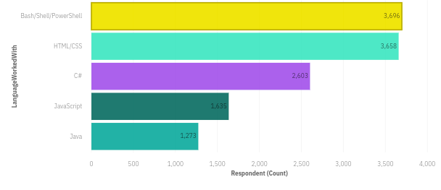
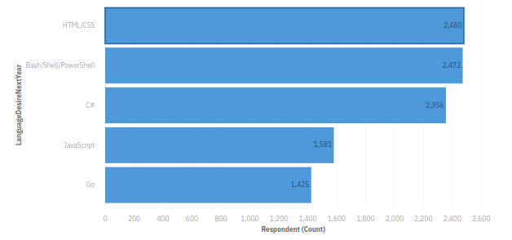
PROGRAMMING LANGUAGE TRENDS
Current Year
Next Year

Slide 8
PROGRAMMING LANGUAGE TRENDS - FINDINGS & IMPLICATIONS
Findings
Bash/Shell/Power Shell and HTML/CSS are top 2 languages both this year and next year
Go will be in the fifth rank instead of java
Users of Bash/Shell/Power Shell and HTML/CSS will decrease by 30% in the following year
Implications
Go is the new trending language
Bash/Shell/Power Shell and HTML/CSS still indemand

Slide 9
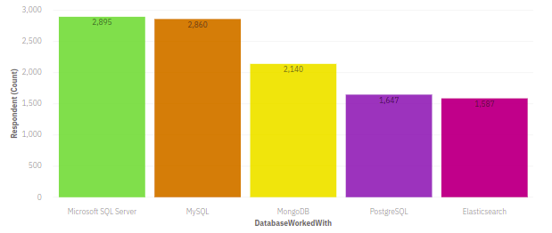
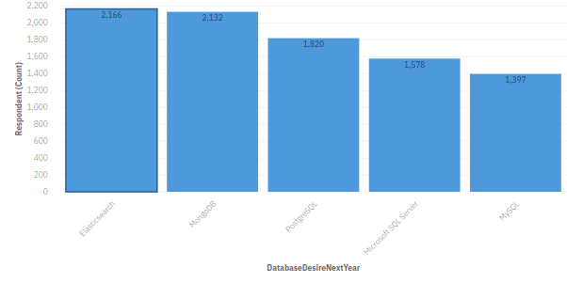
DATABASE TRENDS
Current Year
Next Year

Slide 10
DATABASE TRENDS - FINDINGS & IMPLICATIONS
Findings
Microsoft SQL server is the most popular database
There are still a lot of companies using MySql
MongoDB and postgreSQL are the most favorable NoSQL database
Implications
Open-source databases like MySQL are still preferable
Software development and Big Data technology still requires SQL
NoSQL databases will make an impact for relational databases

Slide 11

DASHBOARD
https://eu-gb.dataplatform.cloud.ibm.com/dashboards/9cf03146-a4c5-46c9-add3-4ba07ba5609b/view/7e03a5247d8a32df47deeae407ca78572e33770ce7bb8b50d2807b490c617597f0601391c87c1f5a8c165132f7ec175b9f

Slide 12
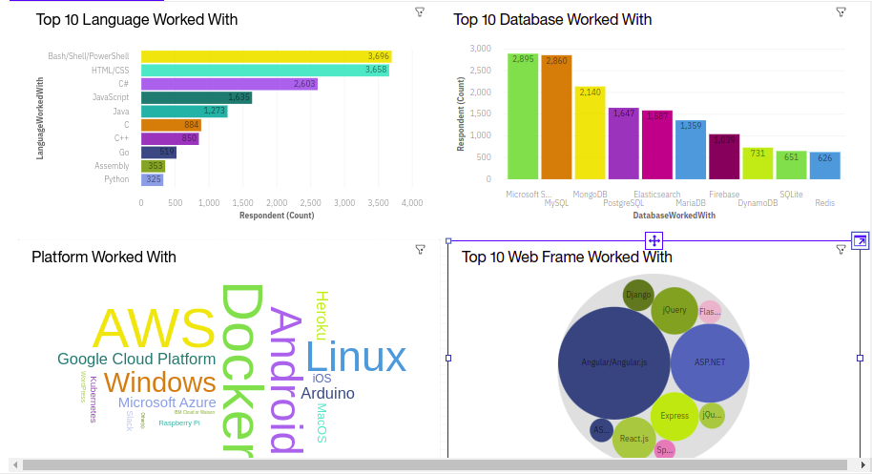
DASHBOARD TAB 1

Slide 13
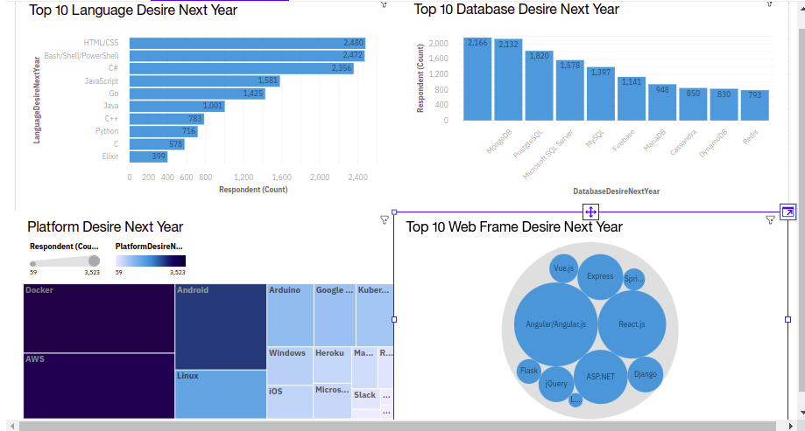
DASHBOARD TAB 2

Slide 14
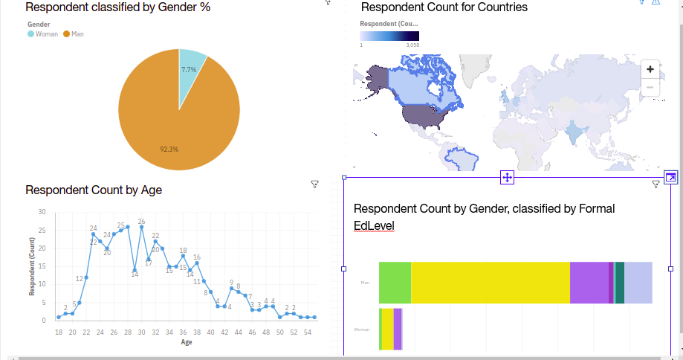
DASHBOARD TAB 3

Slide 15
DISCUSSION
Technology Usage Trend Now and Future
Gender, Age and Education Discrimination in IT Industry

Slide 16
OVERALL FINDINGS & IMPLICATIONS
Findings
Technology trends changes every year
There are extreme gender and age discrimination
Docker and AWS are the most popular platform
Implications
Programmers should always follow the latest technology trends
Further research and changes are required to encourage more women to enter the industry

Slide 17

CONCLUSION
Flexible platforms and databases can optimise systems, improve the performance and closely meet company needs
Young generation is willing to join technology industry.
However, more promotions are needed to women and people from worldwide

Slide 18

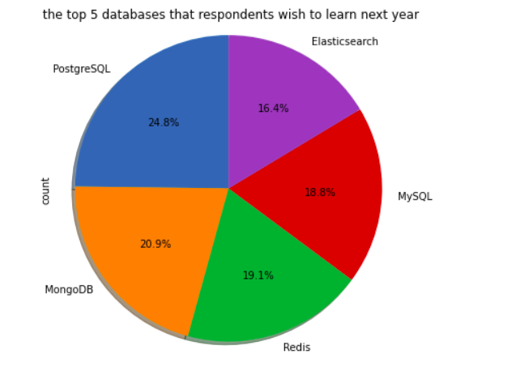
APPENDIX

Slide 19
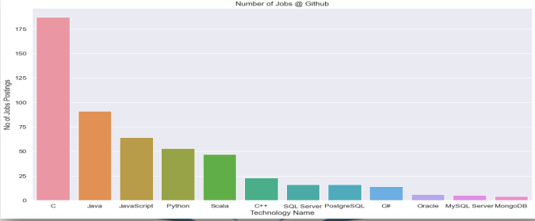
JOB POSTINGS
I

Slide 20
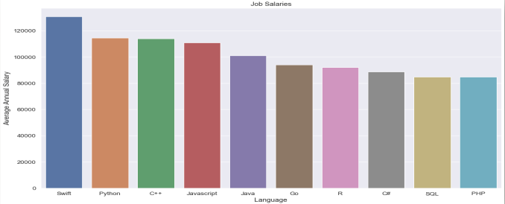
POPULAR LANGUAGES

